Slide 1
Lecture 5 Sequence Diagram
Chapter 19
The Unified Modeling Language User Guide
SECOND EDITION
By Grady Booch, James Rumbaugh, Ivar Jacobson
Session 16
UML Weekend Crash Course
Thomas A. Pender

Slide 2
Introduction
Sequence Diagram is an Interaction Diagram
Another Interaction Diagram is Collaboration/ Communication Diagram
Sequence Diagram represents dynamic interaction view in respect of time
Collaboration/ Communication Diagram represents interaction in respect of structure/ relationship/ links

Slide 3
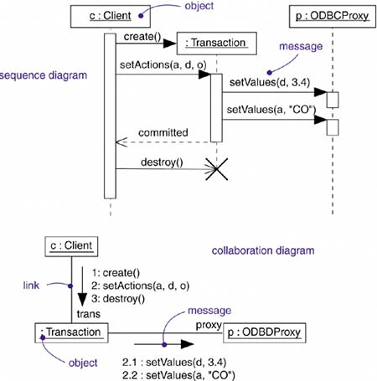
Comparison: Sequence vs. Collaboration/ Communication Diagram

Slide 4
Elements of Sequence Diagram
Objects involved in the interactions as per case study (Dynamic view element)
Distributed on horizontal axis
Messages (Interaction)
Distributed on vertical time-axis starting from top
Types of messages:
Synchronous Messages (Function call with a response/ return)
Asynchronous Messages (Function call without a response when no data value is returned)
Interaction Frames [from version 2.0] (with structured control operators)
ALT, OPT, PAR, LOOP, etc.

Slide 5
Sequence Diagram
Object Axis
Time Axis/
Object lifeline

Slide 6
Messages (Interaction)
A message or stimulus is usually a call, a signal, or a response
A message is represented by an arrow. The type of arrow visually describes the type of message
The solid line and solid arrowhead style represent a message that requires a response known as Synchronous message
The dashed arrows are the responses
An Asynchronous message is used when the event is simply a signal to another object to do something; doesn’t return any value or data
An asynchronous message uses a stick arrowhead

Slide 7
More on Sequence Diagram
Activation: The start of the vertical rectangle, the activation bar
Deactivation: The end of the vertical rectangle, the activation bar
Timeout event: Typically signified by a full arrowhead with a small clock face or circle on the line
Asynchronous event: Typically signified by a stick arrowhead
Object termination symbolized by an X

Slide 8
Sequence Diagram 2.0
Structured Control Operators (Interaction Frames)
‘OPT’: Optional
‘ALT’: Alternate
‘PAR’: Parallel
‘Loop’: Iterative
‘Ref’: Reference
There are many operators, but these are most common

Slide 9
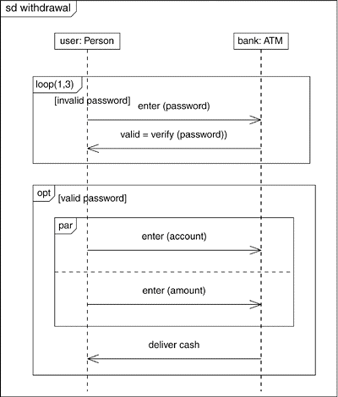
Sequence Diagram with Structured Controls

Slide 10
Case Studies (Without Structured Control Operators)
Case 1
In a withdrawal transaction of an ATM Machine system the customer inserts his ATM card in the machine. The machine then verifies the customer authentication using the information provided in customer account. After successful verification the machine takes withdrawal request from the customer and checks whether the request is valid or not. A valid request is carried out by the machine.
Case 2
In a library management system of a university a member can place a request to book a journal to the librarian. Before the librarian can complete the booking the member has to be verified of his status whether he is allowed to borrow journals or not. The journal then has to be located whether it is in the campus where the request was made or it is in a different campus. If the journal is in a different campus the librarian makes a request for the journal to be sent at the requested campus. The librarian then informs the member about the time required for the journal to reach and completes the booking.

Slide 11
Case 1 (Solution)
In a withdrawal transaction of an ATM Machine system the customer inserts his ATM card in the machine. The machine then verifies the customer authentication using the information provided in customer account. After successful verification the machine takes withdrawal request from the customer and checks whether the request is valid or not. A valid request is carried out by the machine.
:Customer
:ATM
:Database
1. insert( )
2. verify( )
3. return yes
4. return done
5. withdraw( )
6. verify( )
7. return valid
8. carryout( )
9. return done
10. return done

Slide 12
Case Studies (With Structured Control Operators)
Case 3
In a withdrawal transaction of an ATM Machine system the customer inserts his ATM card in the machine. The machine then verifies the customer authentication using the information provided in customer account. After successful verification the machine takes withdrawal request from the customer and checks whether the request is valid or not. A valid request is carried out by the machine. If the withdrawal request is not valid, the request is declined. In case of unsuccessful verification customer authentication the customer request is denied.
Case 4
In a library management system a student can borrow books. When a student brings the books he wants to borrow to the librarian, the librarian places a borrowing request by scanning the student ID. A borrowing object is created at that time which performs all the borrowing related tasks. It checks the student status from the database. If the student is a regular student and doesn’t have any overdue book, the system allows for the books to be scanned. After the books are scanned the data is written in the database and the librarian is informed at the same time. If the student is regular but already has overdue books with him, the request is denied. If the student status is not regular, the request is also denied.

Slide 13
Case 3 (Solution)
In a withdrawal transaction of an ATM Machine system the customer inserts his ATM card in the machine. The machine then verifies the customer authentication using the information provided in customer account. After successful verification the machine takes withdrawal request from the customer and checks whether the request is valid or not. A valid request is carried out by the machine. If the withdrawal request is not valid, the request is declined. In case of unsuccessful verification customer authentication the customer request is denied.
:Customer
:ATM
:Database
1. insert( )
2. verify( )
ALT
[successful]
3. return yes
4. return done
5. withdraw( )
6. verify( )
ALT
7. return valid
[withdrawal valid]
8. carryout( )
9. return done
10. return done
[withdrawal invalid]
7. return invalid
8. return decline
[unsuccessful]
3. return no
4. return deny

Slide 14
In a library management system a student can borrow books. When a student brings the books he wants to borrow to the librarian, the librarian places a borrowing request by scanning the student ID. A session object is created at that time which performs all the borrowing related tasks. It checks the student status from the database. If the student is a regular student and doesn’t have any overdue book, the system allows for the books to be scanned. After the books are scanned the data is written in the database and the librarian is informed at the same time. If the student is regular but already has overdue books with him, the request is denied. If the student status is not regular, the request is also denied.
Case 4
:Student
:Librarian
:Session
:Database
1. Request( )
2. create( )
3. checkStatus( )
ALT
[Regular; no overdue status]
4. return regular; no overdue
5. scan( )
6. return done
PAR
7. write( )
8. return done
7. inform ( )
8. return done
10. return done
9. return done
[Regular; but overdue status]
4. return regular; but overdue
6. return deny
5. return info
[Irregular status]
4. return irregular
6. return deny
5. return info

Slide 15
Case Studies (With Structured Control Operators)
Case 5
When a patient places a request for hospital bed, the system checks if the patient has a reference of a doctor or not. If doctor’s reference is available, the system checks if hospital facilities are available. If facilities are available, the list is sent to the patient. The patient chooses a room or bed. The booking is written in the booking database and the patient is confirmed at the same time. If no facility is available, the system notifies the patient. If doctor’s reference is not available, patient’s request is denied.
Case 6
In a web based login system a user types his username and password and then clicks ‘login’ button. The system creates a session object to run the verification process. The session object sends the information to the database for verification. If the verification is successful, the user is notified. If the verification is not successful and attempt is three or less, the verification process is repeated. If the attempt is more than three times, the username is blocked and user is notified.

